Slide 1

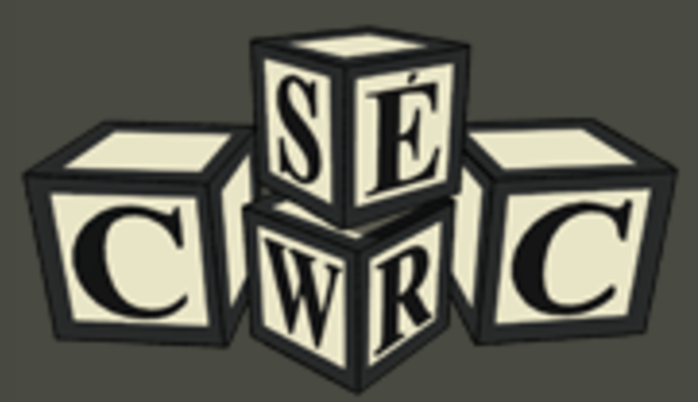
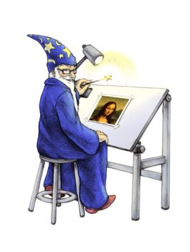




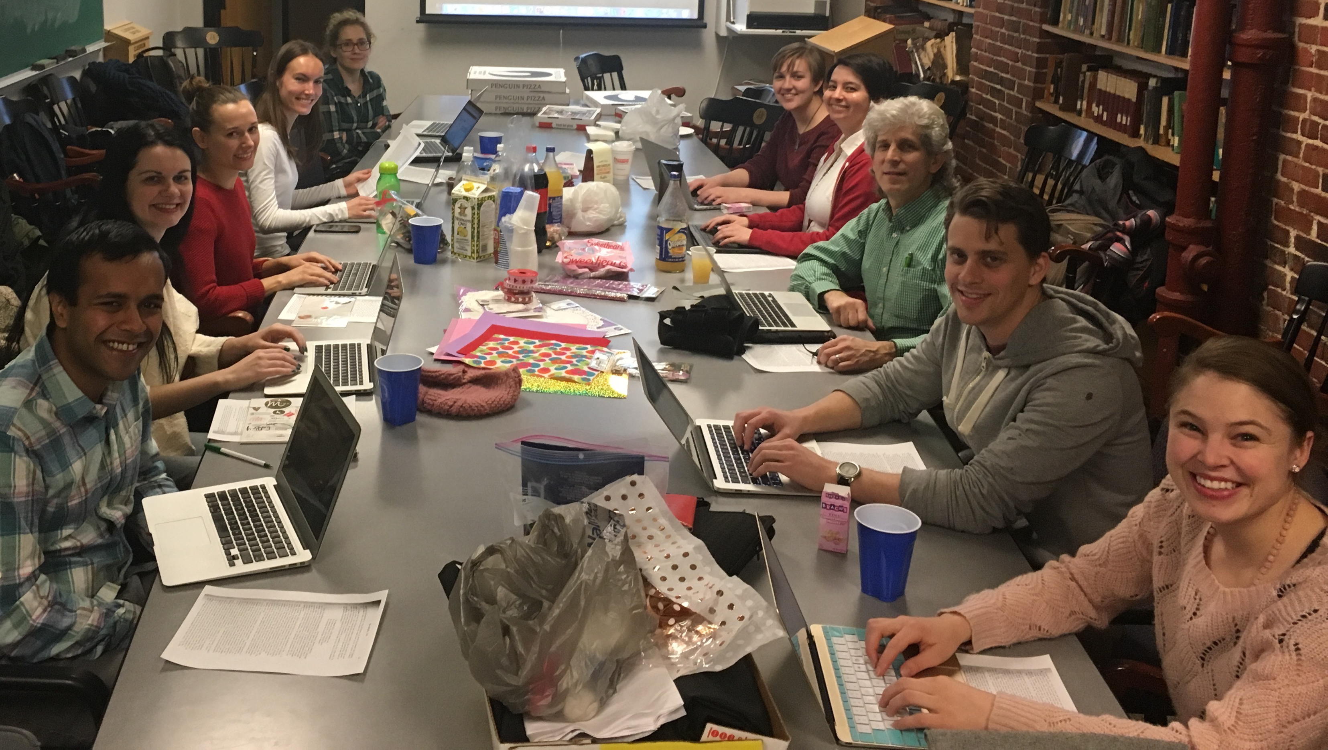

Sarah Sweeney, sj.sweeney@northeastern.edu
Northeastern University Libraries
Digital Scholarship Group
115
Charon: A Repository for Digital Humanities Projects
Components
How can Hydra be used to enable the creation, curation, dissemination, and long-term support of digital humanities (DH) projects and publications? NUL's Digital Scholarship Group seeks to answer this question by using Hydra to develop Charon, a digital curation framework that provides project teams with tools to perform common DH research tasks, including cataloging, text encoding, transcription, and translation.
Editorial Tools
System: Charon
Infrastructure
Kakadu
In Charon, team members are assigned roles and have access to project tasks, which are performed using open source editorial tools embedded in a web interface. Workflows, tools, and task procedures are configured by the project administrator.
Tool
Role
Task
Interface
Tool
Workflows and Interfaces
Role
Task
Interface
Tool
Configure
Submit
Edit
Publish
Curate data
Define workflow
Deposit files
Create metadata
Catalog
Encode
Transcribe
Translate
Design
Build
✏️ Editors
Contribute files and metadata
Claim and execute tasks
Accept and reject deposits
🗄 Depositors
Contribute files and metadata
💡 Creators
Contribute files and metadata
Claim and execute tasks
User Roles
🛠 Administrator(s)
Contribute files and metadata
Claim and execute tasks
Accept and reject deposits
Configure tasks and workflows
Bulk review and file processing
Manage users
You!
This project is still in development and we would like your input! Scan the QR code on the right or visit https://goo.gl/PT1IhE to review and comment on the Charon technical specification. Any and all feedback is welcome!

Slide 2
Sarah Sweeney, sj.sweeney@northeastern.edu
Northeastern University Libraries
Digital Scholarship Group
115
Charon: A Repository for Digital Humanities Projects
CERES Publisher
How can Hydra be used to enable the creation, curation, dissemination, and long-term support of digital humanities (DH) projects and publications? NUL's Digital Scholarship Group seeks to answer this question by developing a digital curation framework that provides workflow management tools to support common DH project activities, such as text transcription and encoding.
REST API
Charon
Components
Kakadu
Fedora 4
Relationships between team members, roles, tasks, interfaces, and tools
Tool
🛠 Configure
Curate data
Manage users
Model metadata
Configure workflow
Role
Task
Interface
Tool
Task
Interface
Tool
Workflows and Interfaces
Role
📮 Submit
Deposit files
Create metadata
✏️ Edit
Catalog
Transcribe
Encode
Translate
Transliterate
Editors
Contribute files and metadata
Claim and execute tasks
Accept and reject deposits
Depositors
Contribute files and metadata
Creators
Contribute files and metadata
Claim and execute tasks
User Roles
Administrator(s)
Contribute files and metadata
Claim and execute tasks
Accept and reject deposits
Configure users, models, and workflows
Bulk review and processing
You!
This project is still in development and we would like your input! Scan the QR code on the right or visit https://goo.gl/PT1IhE to review and comment on the Charon technical specification. Any and all feedback is welcome!
Notes:
https://docs.google.com/document/d/1krYggmrZpcoGa6PuzfrQxmmWE4zNlrFjZaDDdConaHA/edit?usp=sharing

Slide 3
Sarah Sweeney, sj.sweeney@northeastern.edu
Northeastern University Libraries
Digital Scholarship Group
115
Charon: A Repository for Digital Humanities Project Work
CERES Publisher
How can Hydra be used to enable the creation, dissemination, and long-term support of digital humanities projects and publications? NUL's Digital Scholarship Group seeks to answer this question by developing a workflow-based digital framework to provide editorial and other workflow management tools commonly used in digital humanities project work.
REST API
Charon
Components
Kakadu
Fedora 4
Relationships between team members, roles, tasks, interfaces, and tools
Tool
Role
Task
Interface
{ Configure 🛠 }
Manage users
Model metadata
Configure workflow
Tool
Task
Interface
Tool
Workflows and Interfaces
Role
{ Submit 📮 }
Deposit files
Review deposits
{ Edit ✏️ }
Catalog
Transcribe
Encode
Translate
Transliterate
Editors
Contribute files and metadata
Claim and execute tasks
Accept and reject deposits
Depositors
Contribute files and metadata
Creators
Contribute files and metadata
Claim and execute tasks
User Roles
Administrator(s)
Contribute files and metadata
Claim and execute tasks
Accept and reject deposits
Configure users, models, and workflows
Bulk review and processing
You!
This project is still in development and we would like your input! Scan the QR code on the right or visit https://goo.gl/PT1IhE to review and comment on the Charon technical specification. Any and all feedback is welcome!
Notes:
https://docs.google.com/document/d/1krYggmrZpcoGa6PuzfrQxmmWE4zNlrFjZaDDdConaHA/edit?usp=sharing

Slide 4

Sarah Sweeney, sj.sweeney@northeastern.edu
Northeastern University Libraries
Digital Scholarship Group
115
Charon: A Repository for Digital Humanities Project Work
CERES Publisher
How can Hydra be used to enable the creation, dissemination, and long-term support of digital humanities projects and publications? NUL's Digital Scholarship Group seeks to answer this question by developing a workflow-based digital framework to provide editorial and other workflow management tools commonly used in digital humanities project work.
REST API
Charon
Kakadu
Components
ImageMagick
Fedora 4
{ Configure 🛠 }
Manage users
Model metadata
Configure workflow
Tool
Task
Interface
Role
Tool
{ Submit 📮 }
Deposit files
Review deposits
Task
Workflows and Interfaces
Interface
Tool
{ Edit ✏️ }
Catalog
Transcribe
Encode
Translate
Transliterate
Role
Relationships between team members, roles, tasks, interfaces, and tools
Editors
Contribute files and metadata
Claim and execute tasks
Accept and reject deposits
Depositors
Contribute files and metadata
Creators
Contribute files and metadata
Claim and execute tasks
User Roles
Administrator(s)
Contribute files and metadata
Claim and execute tasks
Accept and reject deposits
Configure users, models, and workflows
Bulk review and processing
You!
This project is still in development and we would like your input!
Scan the QR code on the right to review and comment on Charon's technical specification. Any and all feedback is welcome!

Slide 5

Sarah Sweeney, sj.sweeney@northeastern.edu
Northeastern University Libraries
Digital Scholarship Group
115
Charon: A Repository for Digital Humanities Project Work
CERES Publisher
How can Hydra be used to enable the creation, dissemination, and long-term support of digital humanities projects and publications? NUL's Digital Scholarship Group seeks to answer this question by developing a workflow-based digital framework to provide editorial and other workflow management tools commonly used in digital humanities project work.
REST API
Charon
Components
eXistdb
CWRC Writer
Hydra
MySQL
Kakadu
T-Pen
ImageMagick
Fedora 4
{ Configure 🛠 }
Manage users
Model metadata
Configure workflow
Interface
Role
Task
{ Submit 📮 }
Deposit files
Review deposits
Tool
Tool
Workflows and Interfaces
Task
{ Edit ✏️ }
Catalog
Transcribe
Encode
Translate
Transliterate
Role
Interface
Tool
Relationships between team members, roles, tasks, interfaces, and tools
Editors
Contribute files and metadata
Claim and execute tasks
Accept and reject deposits
Depositors
Contribute files and metadata
Creators
Contribute files and metadata
Claim and execute tasks
User Roles
Administrator(s)
Contribute files and metadata
Claim and execute tasks
Accept and reject deposits
Configure users, models, and workflows
Bulk review and processing
Next
This project is still in development and we would like your input!
Scan the QR code on the right to review and comment on Charon's technical specification. Any and all feedback is welcome!

Slide 6
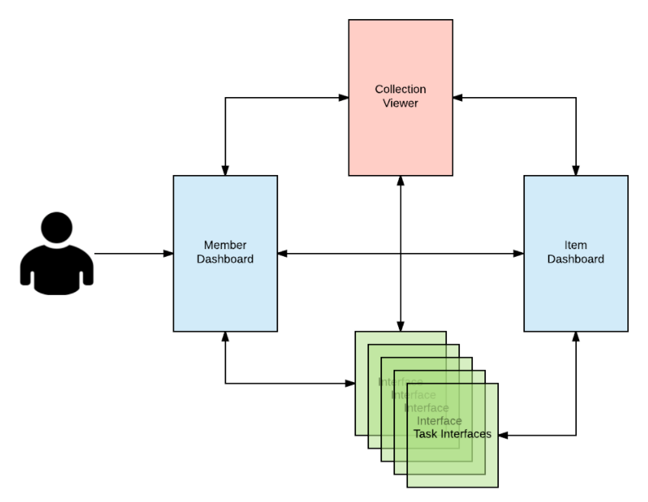
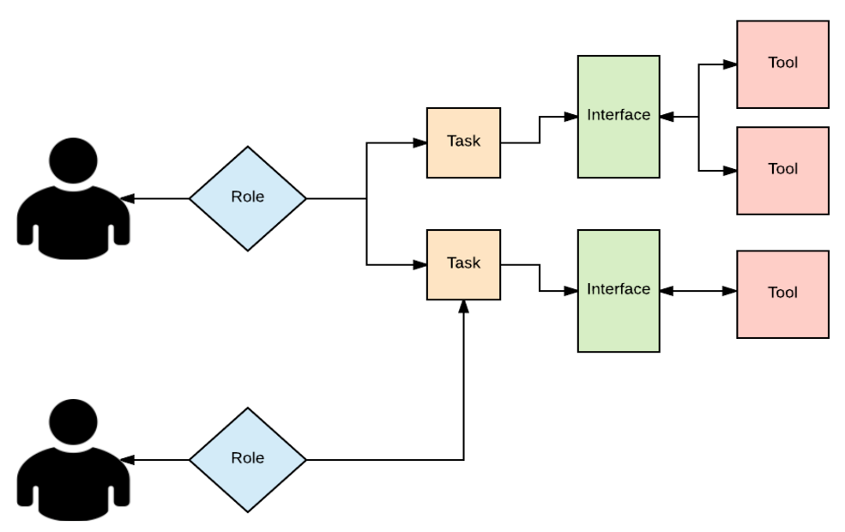
Kakadu
ImageMagick
CERES Publisher
eXistdb
CWRC Writer
REST API
Hydra
MySQL
Kakadu
Charon
T-Pen
ImageMagick
eXistdb
CWRC Writer
Hydra
MySQL
Kakadu
T-Pen
ImageMagick
Fedora 4

Slide 7
Poster Template
IMPORTANT:
This slide has been configured for the screens that will be used to display your poster.
Original template dimensions are 28.584cm x 50.809cm
Do not change these dimensions, otherwise your poster may not display correctly.
If you are not using PowerPoint to create your poster, then you must ensure that your poster dimensions conforms to the same ratio as the template
Insert the 3 digit poster number in the box provided at in the top right-hand corner (see Conftool for your poster number).
Final poster must be submitted (via Conftool) in both PDF and PNG format
Recommended Font Sizes: Title: 60min – 80max Body Text : 22min – 32max (for best effect)
: 18 absolute min – 40 absolute max
Colour:
Solid background colours are recommended, however white should not be used as the brightness of the panel can make it difficult to read when standing in front of it.
To save your poster as an PNG image for display on the Cube:
Click File > Save As
Select PNG from the dropdown Save as type box
Click Save and select “Just This One” when prompted
Please keep a copy of your poster in the original format (eg PowerPoint) as this will allow you to go back and edit your poster again if required
Please enter your poster content on the next slide.
Please upload your final poster (PNG and PDF) by Friday 9th June 2017.

Slide 8
115
Usable Area
Enter poster content here.
Recommended Font Sizes: Title: 60min – 80max Header 1
Header 2
Body Text : 22min – 32max (for best effect)
: 18 absolute min – 40 absolute max
Recommended Font Sizes: Title: 60min – 80max Header 1 (36)
Header 2 (28)
Body Text : 20min – 32max (for best effect)
: 16 absolute min – 40 absolute max

Slide 9
Regular Header
Regular Text
Bulleted list
Item 1
Item 2
Item 3
115
Publish
Edit
Submit
Configure
Main Header
Main Text
Charon:
Using the Repository to Support Digital Humanities Workflows

Slide 10
115
Font Options 1
Regular Text
Bulleted list
Item 1
Item 2
Item 3
Font Options 2
Regular Text
Bulleted list
Item 1
Item 2
Item 3
Font Options 3
Regular Text
Bulleted list
Item 1
Item 2
Item 3
Font Options 3
Regular Text
Bulleted list
Item 1
Item 2
Item 3
Charon:
Using the Repository to Support Digital Humanities Workflows

Slide 11
Charon: Building a Digital Repository to Support DH Workflows
Sarah Sweeney, Northeastern University, sj.sweeney@northeastern.edu
Audience
Our poster will appeal to: repository managers, who will be interested in the various workflows the system will support; developers, who will be interested in the repository technology stack and our plan to integrate external tools; and librarians, who will be interested in how we plan to support our pilot projects using this new system.
Background
This poster will describe our work developing a repository system that will support research workflows typically associated with digital humanities, including transcription, translation, and annotation tasks (“Managing Research Data, Software, and Workflows”). This poster will illustrate the design of this system and describe the digital humanities projects the system is designed to support (“Repositories and Cultural Heritage”).
Poster content
The Northeastern University Libraries Digital Scholarship Group (DSG) works with many project teams to help support their digital humanities research. We are in the process of designing a Hydra head that supports what we have identified as the most common tasks in the digital humanities workspace: annotating, cataloging, proofreading, publishing, text encoding, transcribing, and translating. Charon’s design and development will focus on the needs of three pilot projects, each of which are working to archive and provide research access to digitized cultural materials: “Cherokee Language: Transcription and Translation”, “The Jesuit Relations: A Digital Edition”, and “The Early Caribbean Digital Archive”. The end result will be a contributory and collaborative repository environment for many types of users, which ideally will encourage community engagement with openly accessible digital objects.
The central focus of this new Hydra head will be the editorial and content interfaces, each of which will include features that support collaborative project work. One of the key features of Charon will be the ability to customize the workspace. Project managers will be able to select the edit panes appropriate for their project, construct metadata templates, set up notifications, create and manage user accounts, and design task pipelines. The editorial interfaces will allow users to plan work from a dashboard, submit files, and manage workflows. The content interfaces will enable editing of submitted documents, including encoding and transcribing work. The end result will be collaboratively edited project materials that can be published on the web.
This poster will describe the workflows Charon is designed to support, the technologies and tools we will use to build the system, and it will illustrate the process of designing such a system. Charon will be described visually using a mix of workflow diagrams, user interface mockups, and sample data. Repository managers, developers, and librarians may be interested to learn from our experience of using repository technologies to support digital humanities research workflows, and we are also interested in seeking feedback about the system from the Open Repositories community.
Conclusion
Charon will support the full lifecycle of digital humanities research projects, from data acquisition, to transcribing and translating digitized materials, to recording scholarly annotations, to publishing materials for further research, with the ultimate goal of supporting community engagement with digital humanities research materials.

Slide 12
Regular Header
Regular Text
Bulleted list
Item 1
Item 2
Item 3
115
Publish
Edit
Submit
Configure
Main Header
Main Text
Charon:
Using the Repository to Support Digital Humanities Workflows

Slide 13
115
Regular Header
Regular Text
Bulleted list
Item 1
Item 2
Item 3
Consolas: https://goo.gl/PT1IhE
Corbel: https://goo.gl/PT1IhE
Corbel/Adjusted: https://goo.gl/PT1IhE
Calibri: https://goo.gl/PT1IhE
Arial: https://goo.gl/PT1IhE
Publish
Edit
Submit
Main Header
Main Text
Configure
Charon:
Using the Repository to Support Digital Humanities Workflows

